Slide 1
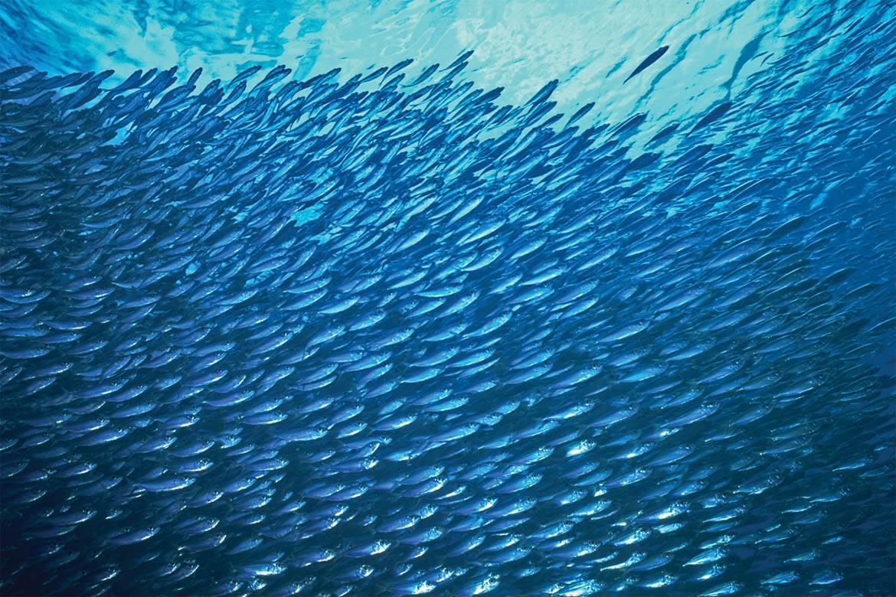
High performance computing in fish school simulation by vortex sheet method
Fang Fang
Applied Math Lab@Courant Inst.
May 19, 2015

Slide 2
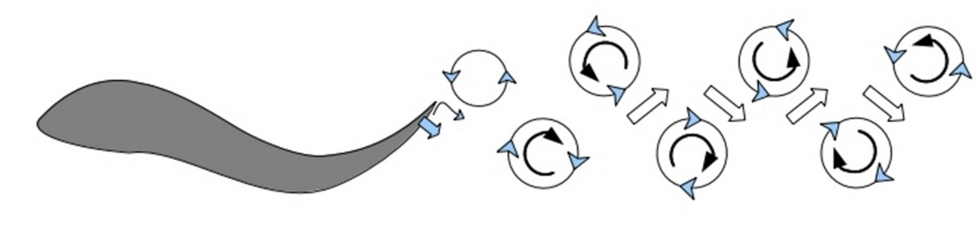
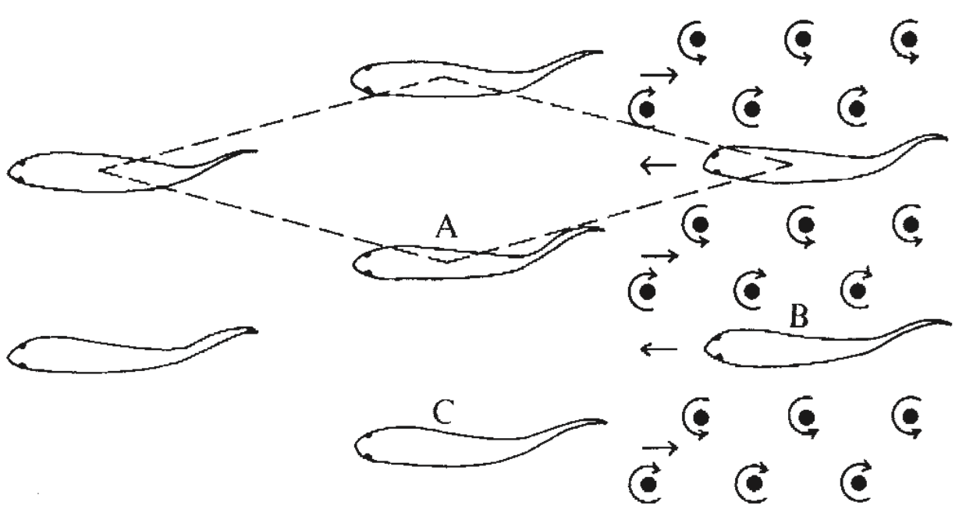
Hydrodynamics of fish schooling — 2D modeling
Fish propels itself by shedding fluid vortices
J. Wills, PeerJ 2003
School simulation is complicated — fluid-structure interaction, multi-body interactions
D. Weihs, Nature 1973
School simulation is expensive
— Number of fish in a school can be large, N~1000 or more

Slide 3
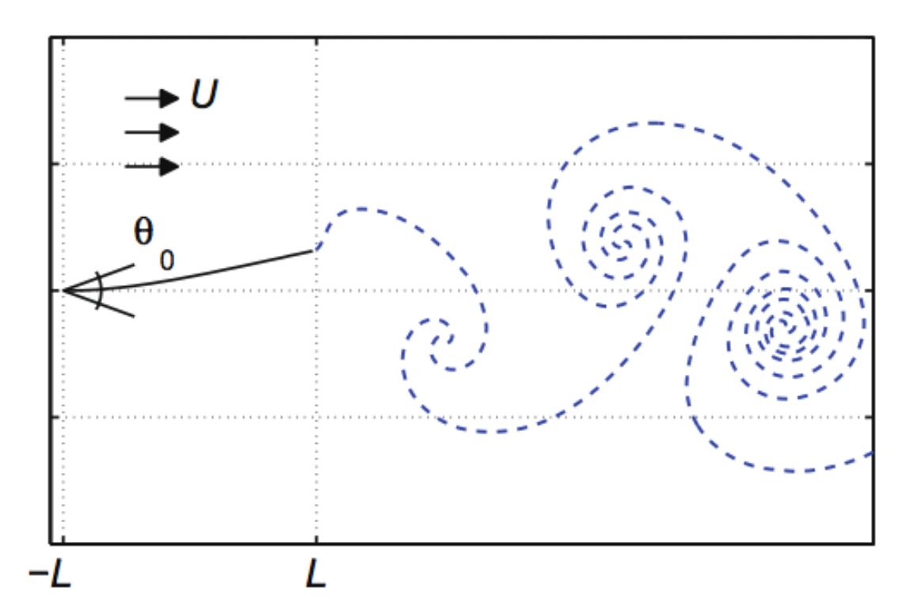
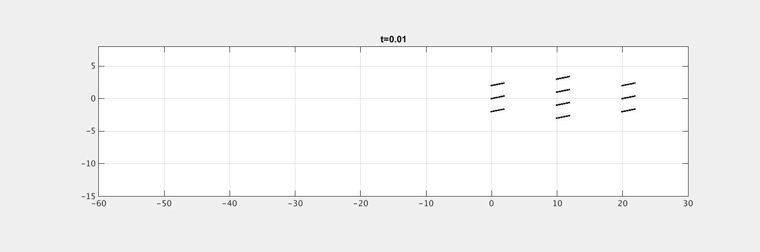
A fish school model using vortex sheet method
Each fish is modeled as a 1D flapping plate
Prescribed flapping motion w.r.t. fish head
Individual fish swims freely under hydrodynamic force and torque
Fish sheds vorticity (vortex sheet) into fluid from tail, vortex sheet develops in flow
S. Alben, JCP 2009

Slide 4
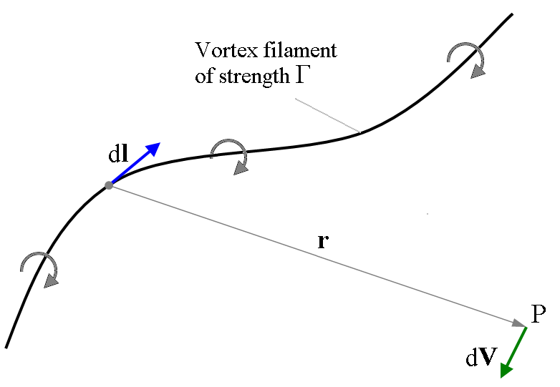
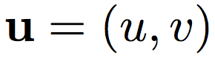
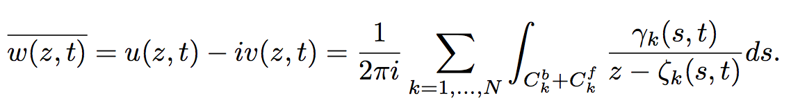
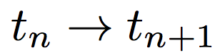
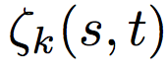
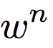
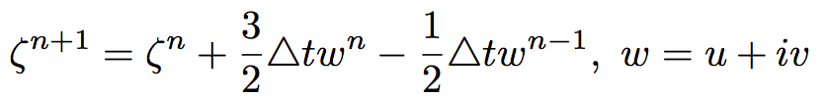
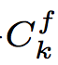
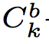
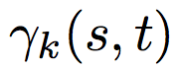
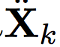
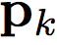
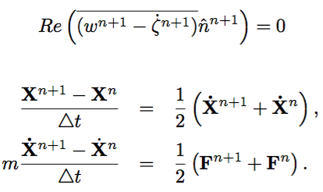
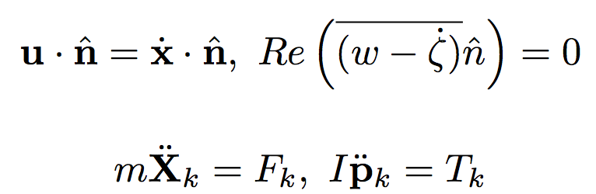

Sketch of simulation algorithm
Biot-Savart law: Evaluate fluid velocity field induced by vortex sheets
(1)
Wikipedia, Biot-Savart Law
From time step :
Step 1. Update positions of free vortex sheets explicitly. Velocity of sheets are evaluated through (1).
Expensive!
Step 2. Through a nonlinear quasi-Newton solver, implicitly solve for fish position , orientation , vorticity distribution, and vortex shedding.
Expensive!

Slide 5

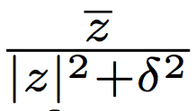
Parallelism of the explicit step
M=100
K=1,000~10,000
# of fish: N=10~1,000
# of points on each fish: M=100
# of points on each vortex sheet: K=1,000~10,000
Total body points: N*M=1,000~1e5
Total vortex sheet points: N*K=1e4~1e7
Parallel evaluations of vortex sheets velocity (NK targets, NM+NK sources)
Induced by sheets — FMM summation over kernel 1/z, NK points self-interaction
O(N^2K^2) (direct) O(NK*logNK) (FMM)
Correct self sheet interaction with smoothing kernel , parallelize
O(K^2) over N fish
O(NK^2) (serial) O(K^2) (parallel) (tests shown later)
Induced by fish bodies — near singular quadrature, singularity subtraction techniques,
parallelize O(MK) over N fish and N sheets
O(N^2KM) (serial) O(MK) (parallel) (in progress…)
O(NK*(NM+NK)) O(NK*logNK)+O(K^2)+O(MK) ~ O(K^2)
serial direct with FMM and parallelism

Slide 6
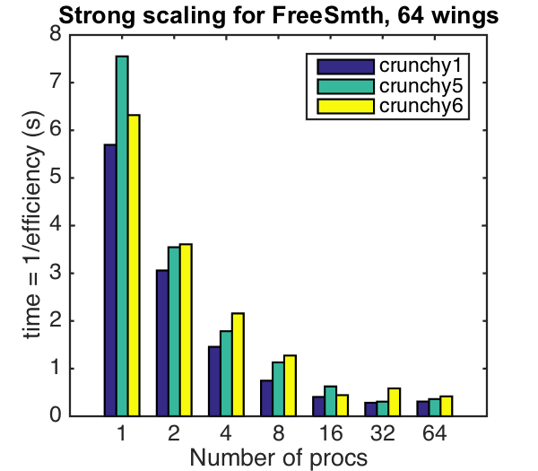
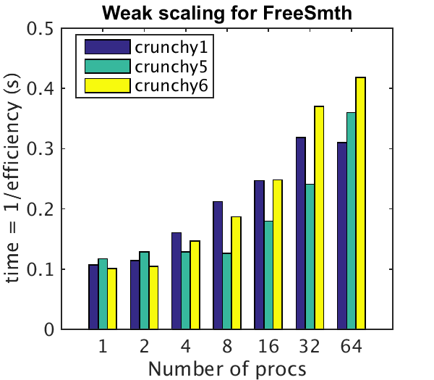
Parallelize vortex sheets self-interaction corrections
Generate N fake vortex sheets in Matlab, implement OpenMP with C++, compiled into Matlab mex functions. K=1,000 points on each sheet,
Sheet 1
Sheet 2
Sheet 3
Sheet N
Vortex sheets data
P1
O(K^2)
P2
O(K^2)
P3
O(K^2)
PN
O(K^2)
Velocity 1
Velocity 2
Velocity 3
Velocity N
Vortex sheets velocity

Slide 7
Parallelism of the implicit step
M=100
K=1,000~10,000
# of fish: N=10~1,000
Total body points: N*M=1,000~1e5
Total vortex sheet points: N*K=1e4~1e7
Parallelizing evaluations of velocity on fish bodies
N independent implicit solvers, each solver performs P newton iterations
NP calls of single body velocity evaluation, in each call M targets, (N-1)*M+N*K sources
Parallel over N implicit solvers (in progress…)
Body velocity induced by other bodies — FMM of kernel 1/z, M targets, (N-1)*M targets
O(NM^2) (direct) less than O(NM*logNM) (FMM)
Body velocity induced by vortex sheets — more accurate quadrature: analytically integrate piecewise linear distribution approximation, parallelize O(MK) interaction over N sheets
O(NMK) (serial) O(MK) (parallel) (tests shown later)
O(NPM*(NM+NK)) O(PNM*logNM)+O(PMK) ~ O(PMK)
serial direct with FMM and parallelism

Slide 8
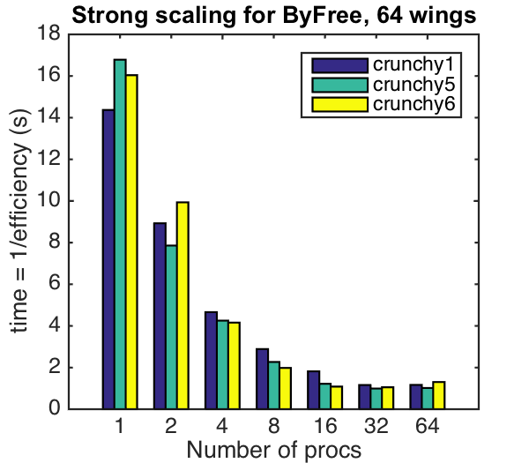
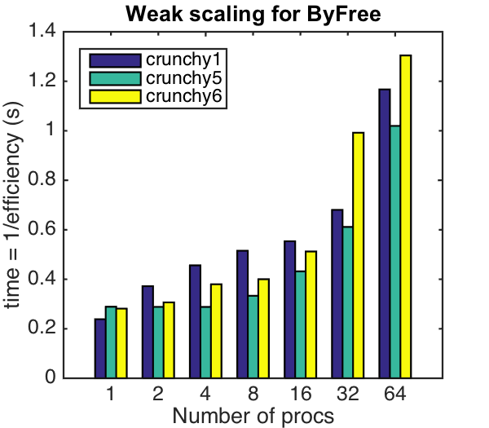
Parallelize body velocity calculation induced by sheets
Generate N fake vortex sheets and M=900 target points in Matlab, implement OpenMP with C++, compiled into Matlab mex functions. K=1,000 points on each sheet.
Targets
(shared)
Sheet 1
Sheet 2
Sheet 3
Sheet N
Vortex sheets data
P1
O(MK)
P2
O(MK)
P3
O(MK)
PN
O(MK)
Sum
sum reduction

Slide 9
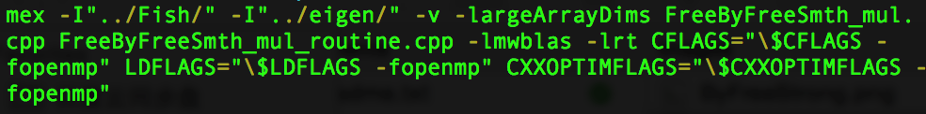
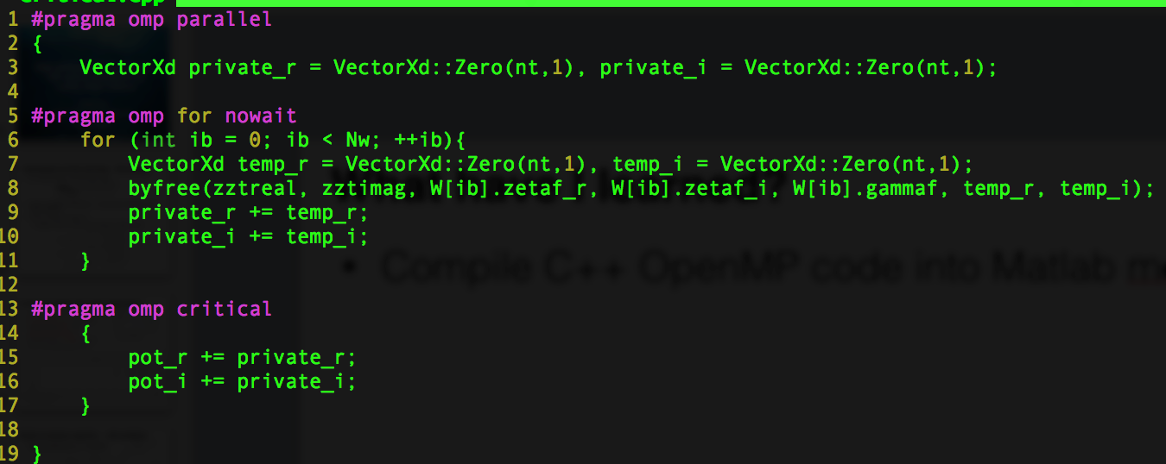
Outlook
Matlab code with current parallelisms is about 5 times faster, for N=10 fish.
Complete the parallelisms, implement for larger fish school
Use kernel independent FMM, or quadrature by expansion (QBX)
What have I learned?
Compile C++ OpenMP code into Matlab mex function
OpenMP sum reduction with overloaded operator
C++ linear algebra package: Eigen.

